Slide 1
Overview
Commercial Games
Reinforcement Learning
Next Steps
Testbeds
Future Challenges
Tutorial
Introduction
Coffee Break
Planning in Games
Machine Learning
Unsupervised Learning
Supervised Learning
Artificial Intelligence
Pathfinding

Slide 2
Overview
Commercial Games
Reinforcement Learning
Next Steps
Testbeds
Future Challenges
Tutorial
Introduction
Coffee Break
Planning in Games
Machine Learning
Unsupervised Learning
Supervised Learning
Artificial Intelligence
Pathfinding

Slide 3
Pathfinding
Introduction
Heuristics
Hierarchical Abstractions
Multi-Agent Pathfinding

Slide 4
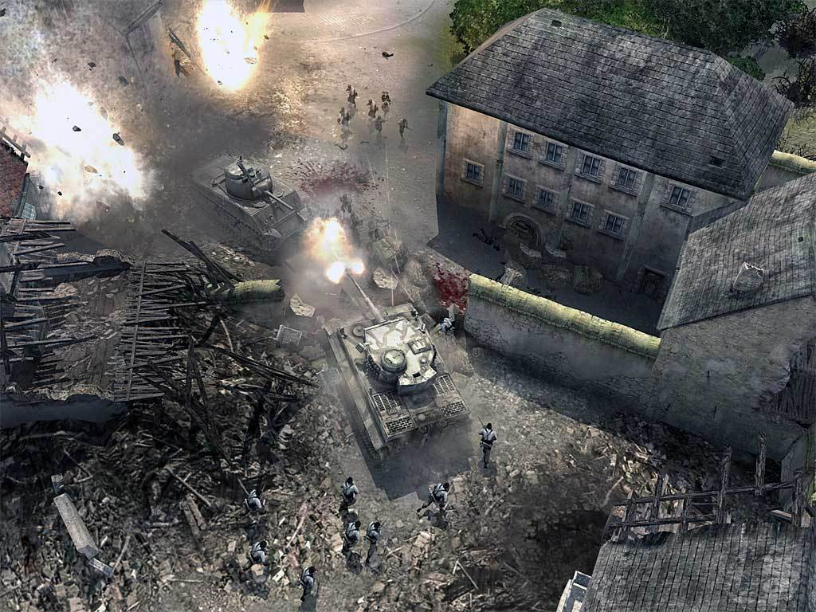
What is Pathfinding?
Find a path between two given locations on a map with obstacles
Notes:
Screenshot from Company of Heroes (Relic Entertainment)

Slide 5
A Broad Area with Many Types of ...
Applications
Games
Robotics
Itinerary planning…
Search Graphs
Grid maps
Navigation meshes
Quad-trees
Waypoints…
Problems
Single agent or multi-agent
Known or unknown environment
Static or dynamic environment…
Performance Criteria
Computation Speed
Path Length
Visual quality
Shape of formations ...
Notes:
Large Literature

Slide 6
A Challenging Search Problem
Need solution in real time
CPU and memory resources are often limited
Huge search space to explore
Multi-agent problems
Large maps ...
Modelling realistic features can impact difficulty
Uncertainty
Heterogeneous terrains and units

Slide 7
Pathfinding 101
Grid Map
Discrete search space
Tiles are either traversable or blocked
Straight and (optionally) diagonal moves
A* (Hart et al 1968)
Best-first search algorithm
De facto standard in games industry (Bjornsson et al 2005)
Manhattan Heuristic
Estimates distance from current node to target
Computed as if there were no obstacles
Admissible: never overestimates real distance

Slide 8

Motivating Example
T
Conclusion:
Some instances are inherently challenging for A*, regardless of the heuristic quality. This includes instances that look easy to humans.
A somewhat similar behaviour has been observed in AI planning domains (Helmert & Roger 2008)
How similar are Manhattan heuristic and perfect distance?
How many nodes does A* expand
S

Slide 9
Speed-up Techniques
Better admissible heuristics
Hierarchical abstraction
Problem decomposition in multi-agent pathfinding
Speed-up Techniques

Slide 10
Speed-up Techniques
Better admissible heuristics
Hierarchical abstraction
Problem decomposition in multi-agent pathfinding
Speed-up Techniques

Slide 11
Admissible Heuristics
Manhattan
Fast to compute
No memory required
Good quality sometimes
Memory-based Heuristics
Reasonably fast to compute at runtime
Use some memory
Aim at good quality
Perfect information
Very expensive to compute and store
Fast to access (once pre-computed)
Impractical

Slide 12
Landmark Heuristics
Family of memory-based heuristics
Landmark: location from which distance to all other nodes is pre-computed
References
Goldberg & Harrelson (2005)
Cazenave (2006)
Bjornsson & Halldorsson (2006)
Grant and Mould (2008)
Sturtevant et al (2009)

Slide 13
Landmark Example
4
3
4
5
11
12
13
14
n
T
h_{L}(n) = |d(L,n) - d(L,T)|
Admissibility proof
d(n,T) >= d(L,T) - d(L,n)
d(n,T) >= d(L,n) - d(L,T)
d(n,T) >= |d(L,n) - d(L,T)| = h_{L}(n)
3
2
3
4
10
11
12
13
2
1
2
3
9
10
11
12
1
L
1
2
8
9
10
11
2
1
2
3
7
8
9
10
Each landmark requires memory comparable to map size
3
2
3
4
5
6
7
8
9
4
3
4
5
6
7
8
9
10
h_{L}(n) = 12 - 4 = 8
h_{M}(n) = 4

Slide 14
Identifying Deadends
n
T
L
h_{L}(n) = Inf - 4 = Inf
h_{M}(n) = 4

Slide 15
Why Use Multiple Landmarks
n
T
A given landmark can give poor
estimates for some nodes.
Multiple landmarks can be
combined in several ways.
E.g., take h(n) = max_{L} h_{L}(n)
L
h_{L}(n) = 8 - 8 = 0
h_{M}(n) = 4

Slide 16
Speed-up Techniques
Better admissible heuristics
Hierarchical abstraction
Problem decomposition in multi-agent pathfinding
Speed-up Techniques

Slide 17
Hierarchical Abstraction
Why should we care?
Recall the example: a good heuristic doesn’t necessarily guarantee fast path computation
What does hierarchical abstraction do?
Reduce the search space to be explored
An enhancement orthogonal to heuristics
Hierarchical path planners
HPA* (Botea, Mueller, Schaeffer 2004)
PRA* (Sturtevant, Buro 2005)
HAA* (Harabor, Botea, 2008)
Relic’s system (Jurney 2007)

Slide 18
Some Properties of Hierarchical Abstraction
Faster path computation than low-level A*
Better first-move lag than low-level A*
Solutions often are nearly optimal, but optimality is usually not guaranteed
Preferably, abstraction is automatic

Slide 19
Overview of HPA*
Preprocessing (once per map)
Build hierarchical search space (abstract graph)
Online processing
Start and target integration
Abstract search
Path refinement
Online demo at AIGameDev.com
http://aigamedev.com/open/article/hpa-pathfinding/
Demo implemented and made publicly available by Alex J. Champandard and Jad Nohra

Slide 20
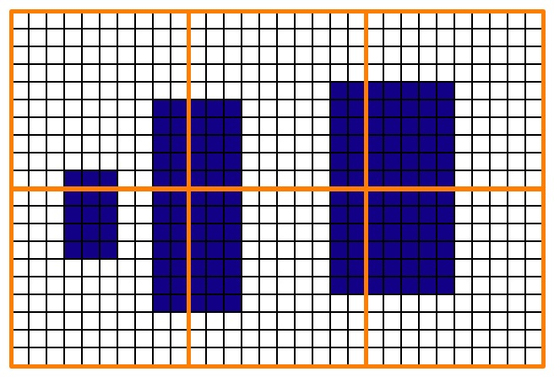
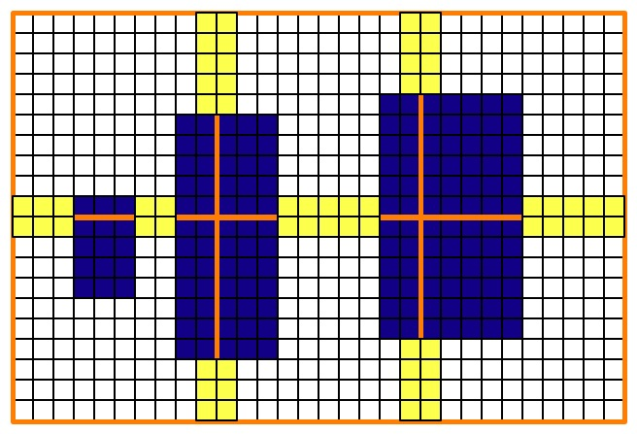
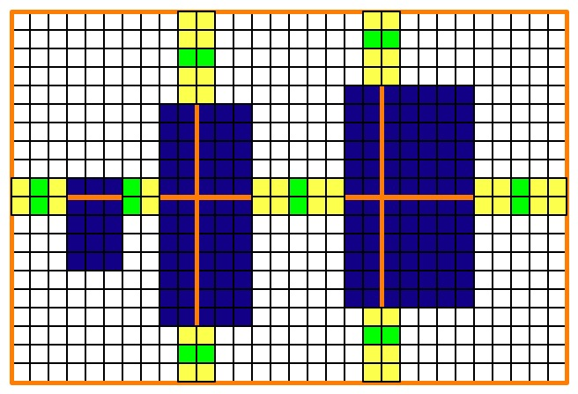
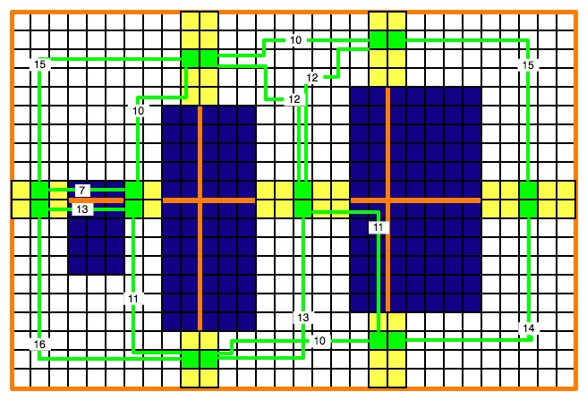

HPA*: Preprocessing

Slide 21
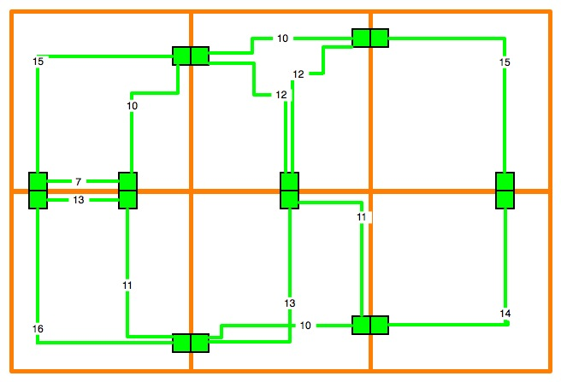
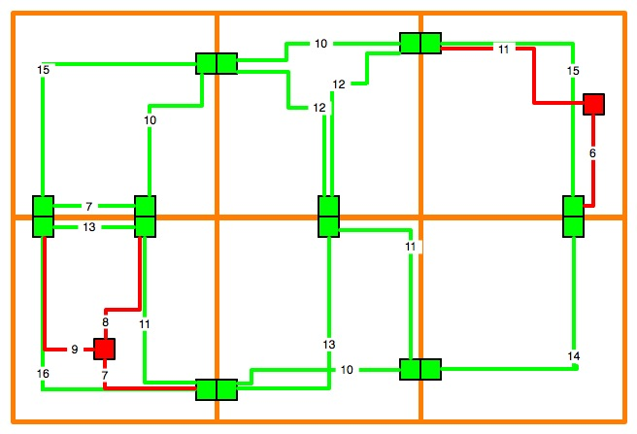
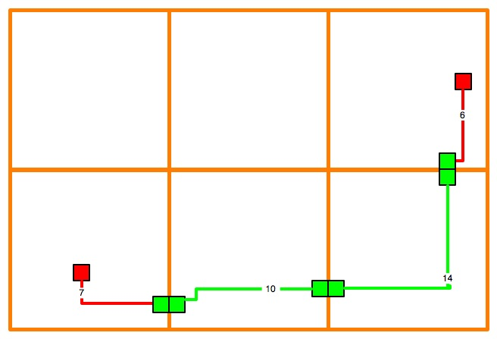
HPA*: Abstract Search Graph

Slide 22
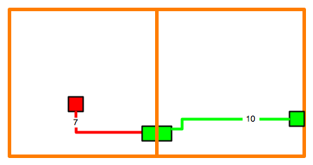
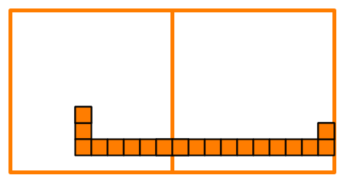
HPA*: Path Refinement
Map abstract edges into actual move sequences
Trade-off: caching and lookup vs online refinement
No need for apriori complete refinement

Slide 23
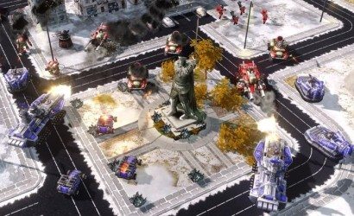
Heterogeneous Terrains and Units

Slide 24
HAA*
Hierarchical pathfinding technique that handles:
Heterogeneous terrains
Heterogeneous mobile units:
Multiple sizes
Multiple terrain traversal capabilities
Demo of HAA*
Implemented by Daniel Harabor on top of Nathan Sturtevant’s HOG

Slide 25
Overview of HAA*
Annotate map to encode terrain and clearance information
Convert an annotated map into a “classical map”
Apply hierarchical abstraction
Reduce size of abstract graph with dominance relationships
Search in abstracted space

Slide 26
Map Annotation
3
3
3
3
4
3
2
1
1
1
6
6
5
5
4
4
4
3
2
1
3
2
2
2
3
3
2
1
1
1
6
5
5
4
4
3
3
3
2
1
2
2
1
1
3
3
2
2
2
1
6
5
4
4
3
3
2
2
2
1
2
1
1
2
2
2
1
1
1
1
6
5
4
3
3
2
2
1
1
1
2
1
1
1
2
1
1
1
1
6
5
4
3
2
2
1
1
1
2
1
1
1
1
1
1
2
1
5
5
4
3
2
1
1
1
1
2
2
1
1
2
1
1
1
4
4
4
3
2
1
2
1
2
3
2
1
3
3
2
1
1
3
3
3
3
3
3
3
2
1
2
2
2
2
2
2
2
2
2
1
2
2
2
2
2
2
2
2
2
1
1
1
1
1
1
1
1
1
1
1
1
1
1
1
1
1
1
1
1
1
There is one annotated map for each traversal capability (combination of terrains)
Numbers are clearance values: size of largest square unit that can have upper-left tile on that cell.
Example created by Daniel Harabor

Slide 27
Conversion to Classical Problems
3
3
3
3
4
3
2
1
1
1
3
2
2
2
3
3
2
1
1
1
2
2
1
1
3
3
2
2
2
1
2
1
1
2
2
2
1
1
1
1
Clearance = 2
2
1
1
1
2
1
1
1
1
2
1
1
1
1
1
1
2
1
2
2
1
1
2
1
1
1
2
3
2
1
3
3
2
1
1
2
2
2
2
2
2
2
2
2
1
1
1
1
1
1
1
1
1
1
1
Classical problem:
Mobile units have unit size
Homogeneous terrain
An efficient implementation doesn’t explicitly perform such conversions

Slide 28
Hierarchical Abstraction
Similar to HPA*
This time, consider many combinations of terrains and clearance values
Size of abstract graph is kept low using edge dominance relationships

Slide 29
Edge Dominance
Definition: Edge e₁ strongly dominates edge e₂ if
Edges connect the same two nodes
They are computed for the same terrain capability
They have the same length
Edge e₁ has a larger clearance
Consequence: Edge e₂ can be eliminated with no optimality loss
Weak dominance: allows further pruning at the price of further optimality loss:
Prune a shorter edge if a longer edge, computed for larger units, exists

Slide 30
Speed-up Techniques
Better admissible heuristics
Hierarchical abstraction
Problem decomposition in multi-agent pathfinding
Speed-up Techniques

Slide 31
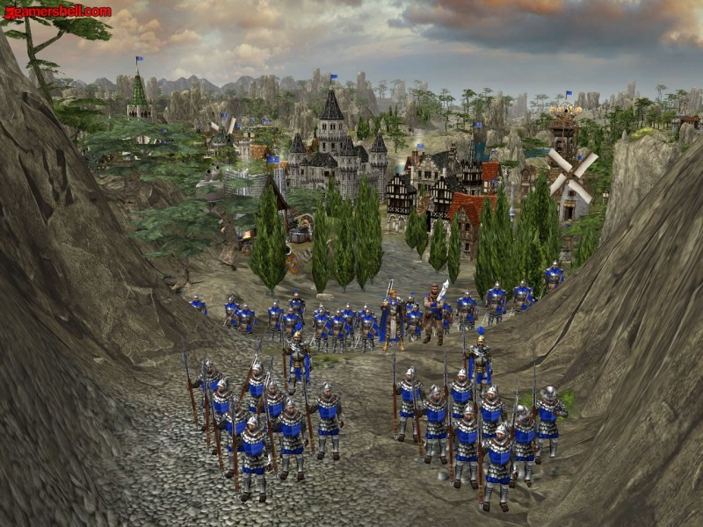
Multi-Agent Pathfinding
Objective: Have all units navigate to their targets (collaborative pathfinding)
A much harder problem than single-agent pathfinding
State space size blows up from O(m) to O(m^{n}), where m is number of tiles, and n is number of mobile units
Branching factor blows up from a small constant (e.g., 4 or 8) to 5^{n} or 9^{n}

Slide 32
Solving Strategies
Centralized search
E.g., single-agent A* on global state space
Complete and optimal
Impractical even in moderate-size problems
Decentralized search
Decompose problem into several searches
Most often, completeness and optimality are lost
Able to scale up to large problems
References:
WHCA* (Silver 2005; Sturtevant and Buro 2006)
FAR (Wang and Botea 2008)
MAPP (Wang and Botea 2009)

Slide 33
FAR
Aim at low CPU and memory usage
Pre-processing
Objective: avoid head-on collisions
Annotate map with flow restrictions inspired from real-life roads
Path planning
Compute one path per unit while ignoring all other units
Later, try to solve collisions and deadlocks with local, cheap techniques
No large-scale replanning

Slide 34
Flow Annotation
Annotated Map
Basic rule: have a direction on each row and column, as directed lanes on a road
Preserve connectivity: two connected locations must remain connected in both directions
Normal maps allow bi-directional flow

Slide 35
Path Planning in FAR
Pre-compute a path for each unit independently
When deadlocks occur, try to repair them cheaply
A selected unit in a deadlock temporarily changes its goal from “progress along the pre-computed path” to “step outside the deadlock”
Demo of FAR
Implemented by Ko-Hsin Cindy Wang on top of Nathan Sturtevant’s HOG

Slide 36
MAPP
Tractable multi-agent path planning algorithm that is complete in certain sub-classes of problems
Able to tell whether it will find a solution for a given input problem
Low polynomial upper bounds on time and memory
Presented at IJCAI-09 by Ko-Hsin Cindy Wang

Slide 37
Overview
Commercial Games
Reinforcement Learning
Next Steps
Testbeds
Future Challenges
Tutorial
Introduction
Coffee Break
Planning in Games
Machine Learning
Unsupervised Learning
Supervised Learning
Artificial Intelligence
Pathfinding

Slide 38
Planning in Games
Major AI Research Area
Planning task: compute a collection of actions that achieve an objective when applied in the current state
Applying planning to games
Potential two-way benefits
Game developers can use existing planning technology
Planning researchers can get interesting and realistic benchmark domains
An active area in recent years

Slide 39
Where is Planning Useful?
First-person shooter (FPS) games
NPC individual and team strategy
References
Orkin (2003, 2006)
Huang, Lee-Urban, Munoz-Avila (2005)
Smith, Lee-Urban, Munoz-Avila (2007)
Gorniak & Davis (2007)
Role-playing games (RPGs)
NPC behaviour
References
Kelly, Botea, Koenig (2008)
Real-time strategy (RTS) games
Accumulate resources
Army deployment and combat
References
Chan, Fern, Ray, Wilson, Ventura (2007)
Sugandth, Ontanon, Ram (2008)
Trusty, Ontanon, Ram (2008)
Chung, Buro, Schaeffer (2005)
Sailor, Buro, Lanctot (2007)
Interactive storytelling
Barros, Musse (2005, 2007)
Camera control
Jhala, Young (2006)

Slide 40
Benefits of Planning
Good Alternative
Finite state machines (FSMs)
Manual creation of scripts
Rigid scenario repetition
Achieve Better Functionality
NPC coordination
Compute strategies in RTS games

Slide 41
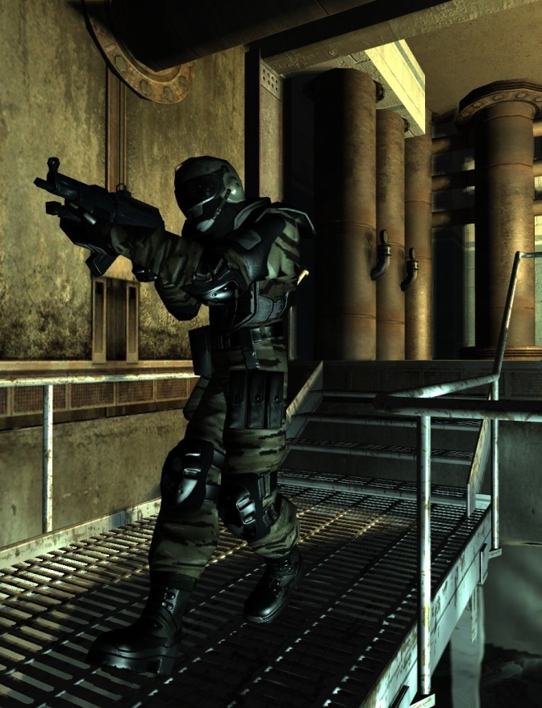
F.E.A.R.
Why?
Where?
How? GOAP
Much more scalable than FSMs
Two years of development made FSMs too complex and unmanageable
Online computation of plans for individual NPCs
Illusion of squad coordination
A* Search with STRIPS-like encoding
Procedural preconditions and effects
Expensive preconditions are computed in several frames to avoid getting idle
An NPC’s goals compete for activation

Slide 42
Explicit Squad Coordination
How to do it:
Online planning with SHOP (Nau et al. 2003) and hierarchical task networks (HTNs)
Policy learning
References
Huang, Lee-Urban, Munoz-Avila (2005)
Smith, Lee-Urban, Munoz-Avila (2007)
Gorniak & Davis (2007)

Slide 43
Unreal Tournament
First person shooter game – Epic Games Inc.
One variant is a dominance game
Systems
(Huang, Lee-Urban, Munoz-Avila 2005) use SHOP (Nau et al. 2003) and hierarchical task networks (HTNs)
RETALIATE (Smith, Lee-Urban, Munoz-Avila 2007) is based on policy learning

Slide 44
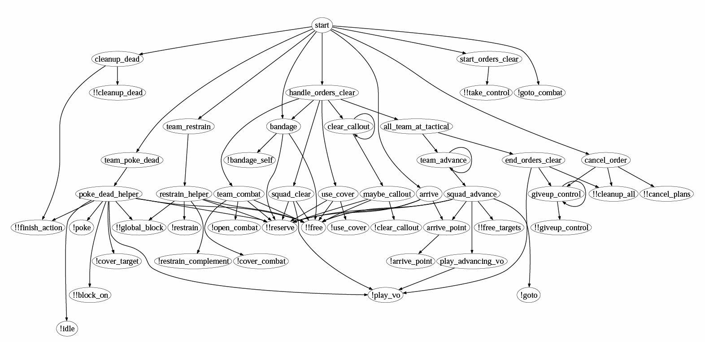
SquadSmart (Gorniak & Davis, 2007)
Coordinate a 4-member police squad
Restrain surrendered suspects
Use SHOP2 (Nau et al 2003) and HTNs
Online planning
Time slicing: spread planning over frames

Slide 45
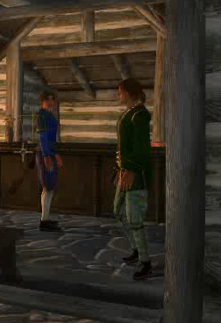
Offline HTN Planning (Kelly, Botea, Koenig, 2008)
Application domain
Elder Scrolls IV: Oblivion, an RPG developed by Bethesda Softworks
Objective
Plan daily schedules for NPCs
Make NPCs interact with each other
Make their actions coherent and realistic

Slide 46
Offline HTN Planning (Kelly, Botea, Koenig, 2008)
Main benefit of planning
Automate the process of creating scripts
Less human input, more complex scripts
Approach
Offline planning with SHOP2 and HTNs
Use scripting interface to feed in plans with no changes to game engine

Slide 47

Adding Plans Through Scripting Interface
JSHOP2
Planner
HTN
Problem
Game
Plan
Script
Scripting
interface
Control NPCs,
environment…
Translator

Slide 48
Planning Conclusions
Useful in quite a few game sub-problems
Current planning technology: mature enough to make a difference in games
Forward-search planning, hierarchical planning…
Off-the-shelf systems (SHOP)
Also, plenty of scope for future work
Look more into handling dynamic nature of problem at planning time

Slide 49
Overview
Commercial Games
Reinforcement Learning
Next Steps
Testbeds
Future Challenges
Tutorial
Introduction
Coffee Break
Planning in Games
Machine Learning
Unsupervised Learning
Supervised Learning
Artificial Intelligence
Pathfinding

Slide 50
The Open Racing Car Simulator
Multi-platform car racing simulation (Linux, FreeBSD, MacOSX and Windows) under GPL
50 different cars, more than 20 tracks, and 50 opponents
Lighting, smoke, skid-marks and glowing brake disks
Damage model, collisions, tire and wheel properties, aerodynamics
http://torcs.sourceforge.net/

Slide 51
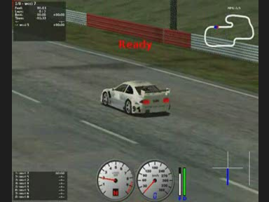
Car Racing @ WCCI 2008: TORCS (Julian Togelius, organizer)

Slide 52
Neuro-Evolving Robotic Operatives
Based on real-time NeuroEvolution of Augmenting Topologies (rtNEAT)
Goals of NERO:
Demonstrate the power of state-of-the-art machine learning technology
Create an engaging game based on it
Provide robust and challenging development and benchmarking domain for AI researchers
http://www.nerogame.org/

Slide 53
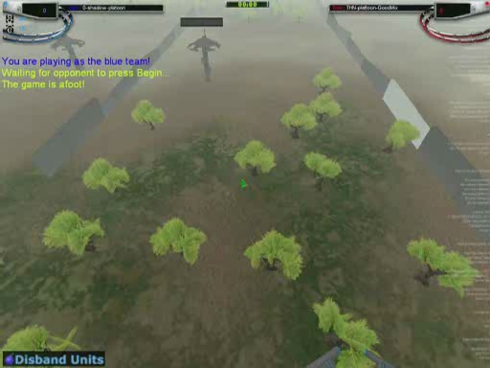
Neuro-Evolving Robotic Operatives

Slide 54
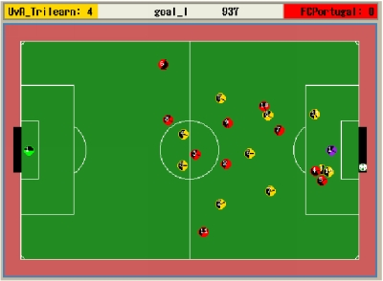
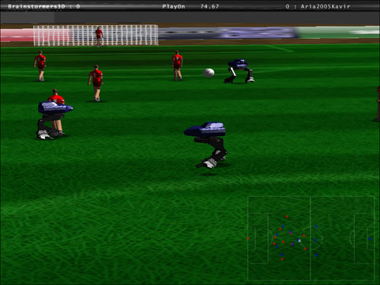
RoboCup Simulation League
Each simulated robot player has its own play strategy
Every simulated team consists of a collection of programs.
The games last for about 10 minutes.

Slide 55
RoboCup: Sensors and Actions
Sensors
Aural
Visual
Physical
Actions
Catch (Goalie only)
Dash
Kick
Move
Say
Turn
Turn Neck
Limited capacity
Limited range
Field of View
Range of View
Noisy
More information: http://sserver.sourceforge.net/

Slide 56
Overview
Commercial Games
Reinforcement Learning
Next Steps
Testbeds
Future Challenges
Tutorial
Introduction
Coffee Break
Planning in Games
Machine Learning
Unsupervised Learning
Supervised Learning
Artificial Intelligence
Pathfinding

Slide 57


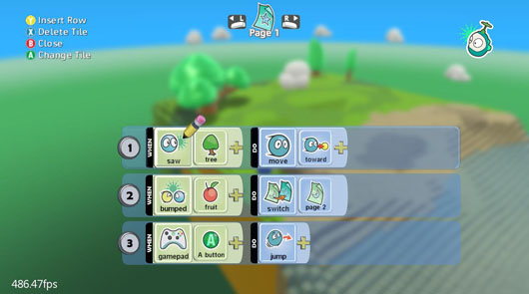
Future Challenges for Artificial Intelligence in Games
Mentioned in this talk
Adaptive Game AI
Online Gaming Interactions
Not mentioned in this talk
Dialogue Generation
Computer Vision
Pathfinding & Planning
New Game Genres
Adaptive Input Devices
Realistic Physical Movement

Slide 58
Crowd Control Racing Demo
Crowd Control Demo
Car Steering by Body Movement
Template Learning
Notes:
RL has learnt what to maximize, rather than copying the priming lap

Slide 59
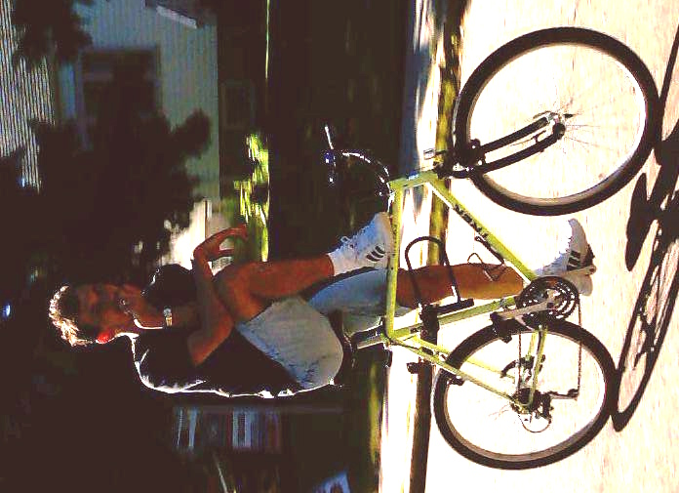


Conclusions
Computer games can be used as test beds for research.
Artificial Intelligence and Machine learning can be used to improve the user experience in computer games.
Both research and applications are in their infancy and there are many open questions.
For more question, please drop us a line
Adi Botea
Ralf Herbrich
Thore Graepel

